Slide 1
DETECTION OF COTTON LEAVES DISEASE
By
ravjot singh rayat(20cse167)
e kavya(20CSE145)
Rahul kumar kuila(20CSE283)

Slide 2
CONTENTS
O1 INTRODUCTION
02 SYSTEM REQUIREMENTS
03 CONCEPT BEHIND THIS SYSTEM
04 TESTING
05 CONCLUSION AND LIMITATIONS

Slide 3
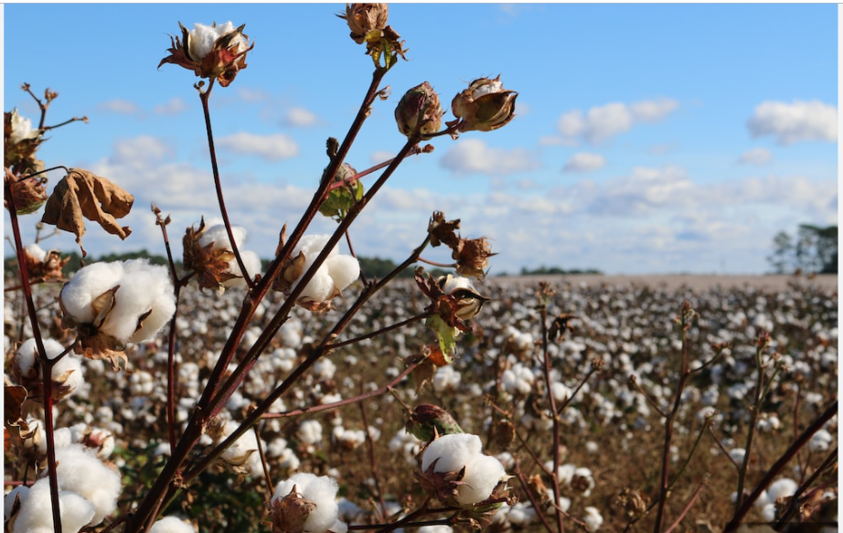
ABOUT OUR PROJECT
Cotton is a major agricultural crop that is grown worldwide for its fibers, which are used to make textiles. However, cotton plants are susceptible to a variety of diseases, which can greatly reduce yields and cause significant economic losses for farmers. Early detection and diagnosis of these diseases is crucial for farmers to take timely and appropriate action to prevent the spread of diseases and minimize losses.
In this project, we aim to develop a computer vision system to automatically detect and classify different cotton leaf diseases. Our system uses image processing techniques to extract features from images of cotton leaves, which are then fed into a machine learning model to identify the presence and type of disease. We evaluate our system on a dataset of images of cotton leaves with different disease and assets its performance in detecting and classifying the diseases.

Slide 4
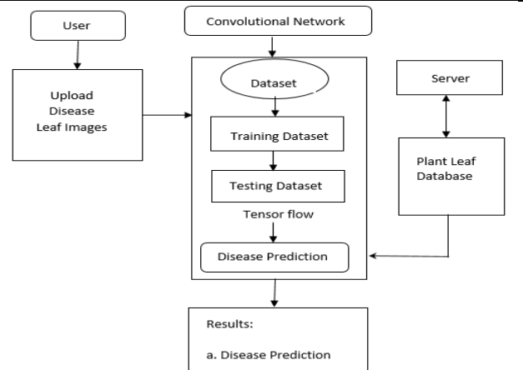
WORK FLOW DIAGRAM

Slide 5
SYSTEM REQUIREMENTS
HARDWARE REQUIREMENTS:-
RAM: 8GB
WINDOWS 10 OR 11
i5 PROCESSOR
GRAPHIC CARD – Intel UHD 620
SOFTWARE REQUIREMENTS:-
JUPYTER NETWORK
FAST API
VISUAL STUDIO CODE
REACT JS

Slide 6
CONCEPT BEHIND THIS DETECTION SYSTEM
Image pre-processing:-
In this phases, we require better resolution images and with better quality. All these images are resized with specific manner and resolution. These images we remove noise content and rotate the images using a data augmentation process.
Data augmentation:-
There are 4 classes of diseases for which the images were collected. These images were less in number. A deep learning based approaches need more images, we have performed data augmentation using MATLAB. This is one process which gives 10 rotated versions of original images. We have used various data science related libraries like keras, tensorflow, fatsapi, opencv, matplotlib, numpy, etc.

Slide 7
Image Segmentation:-
It is a process of dividing a digital image into various sections. Its use to remove the region of the pixel in infected leaf and easily identified the moel which part is infected.
Feature Extraction:-
It extacts some of the important features of the defected leaf. It can create colored structure and convert the color value from RGB components of defected parts of cotton leaf image. This feature can be used to train our neural network. When all processes are done then we give the train and test data to the model and apply the CNN algorithm.

Slide 8
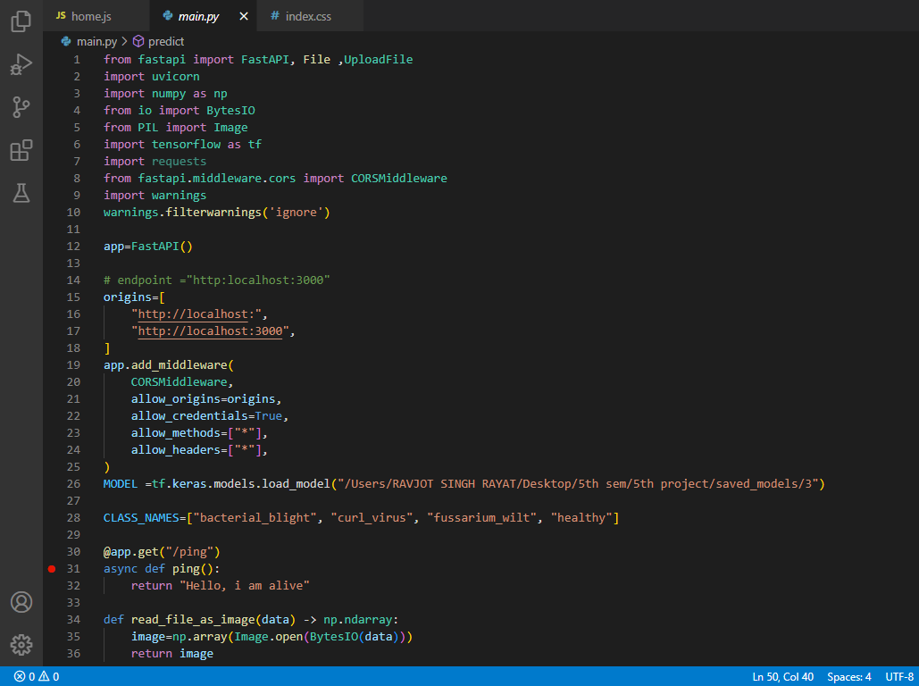
CODING

Slide 9
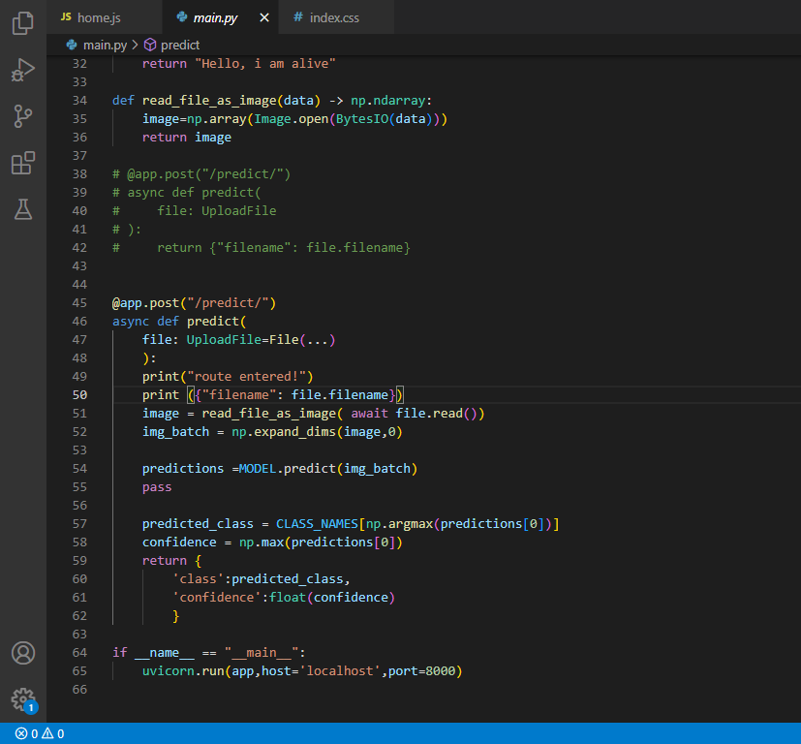
CODING

Slide 10
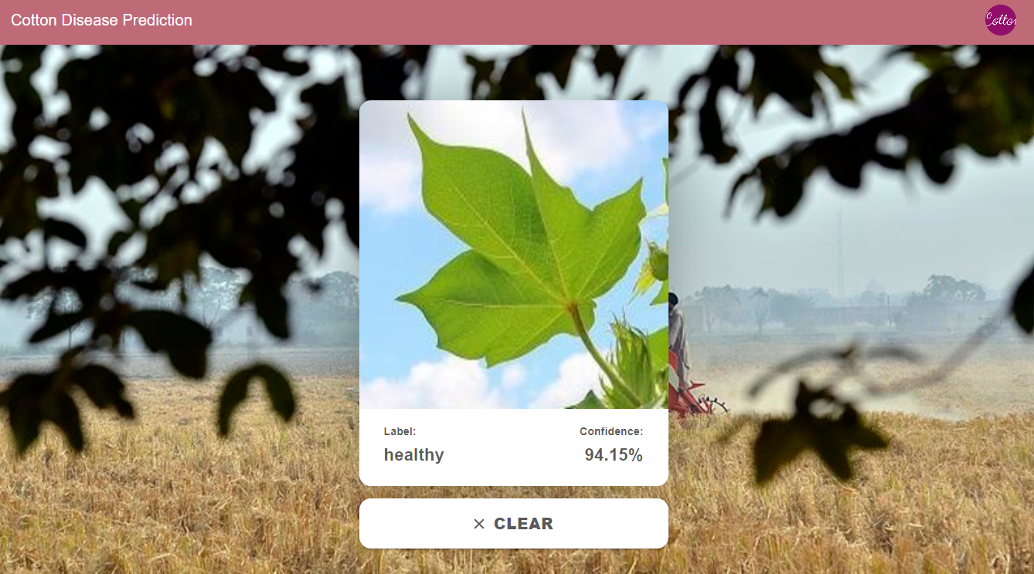
TESTING

Slide 11
CONCLUSION AND LIMITATION
One potential limitation of this project is that it may only be effective in detecting diseases in cotton leaves withb a resolution of 256*256 pixels. This may limit the accuracy of the predictions, as images with a higher or lower resolution may not provide the same level of detail to the CNN. Additionally, the effectiveness of the CNN in detecting diseases in cotton leaves may be limited by the quality and diversity of the training data used to train the model. If the training data is not representative of the types of diseases and conditions that the model will encounter in real-world scenarios, the model may not be able to accurately predict the presence of diseases in new images.
This model can only predict the image of size 256*256 size and if any other image is given as input then it can’t predict whether it is the leaves of cotton or not. It says the confidence % is less.

Slide 12
Thank You

